Slide 1
How Could It Happen?
What Led to the Holocaust?
Notes:
Students should complete the “How Could It Happen Notes” as they follow along this presentation. There are fill-in-the-blank notes, quick writes, etc. Be sure to allow time for students to complete and to discuss answers to quick writes as a class, etc.

Slide 2
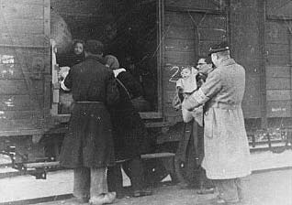
Inference Activity
Notes:
Ask students to write one sentence explaining what they think is happening in this picture.

Slide 3
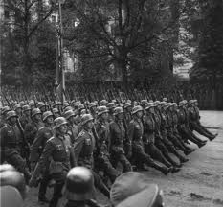
World War II Basics
Germany started World War II by invading Poland on September 1, 1939.
Britain and France responded by declaring war on September 3.
Germany defeated Poland and proceeded to invade the surrounding countries (Netherlands, Belgium, Luxembourg, and France).
Notes:
Additional Info:
US enters the war on Dec 7, 1941 because of Pearl Harbor
France is defeated by Germany and becomes occupied

Slide 4
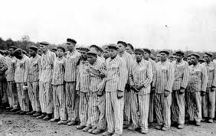
What is “The Holocaust”?
The systematic killing of millions of Jews and other ethnic group.
Holocaust comes from a Greek word, meaning “sacrifice by fire.”

Slide 5
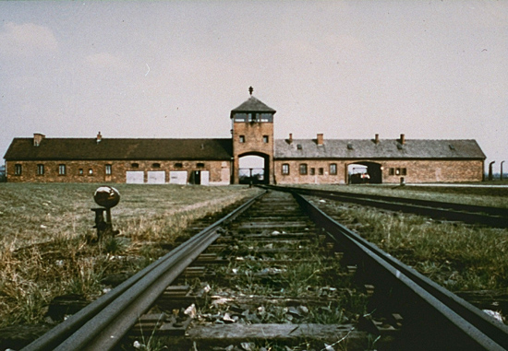
How could something like the Holocaust happen? What caused the Holocaust?
Notes:
Ask students to write down 1-2 thoughts on these two questions.

Slide 6
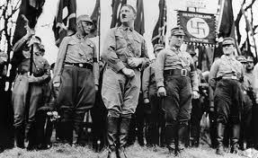
Contributing Factors to the Holocaust
Adolf Hitler and his Nazi government came into power in Germany . Germany was still recovering from World War I, was facing the Great Depression, and was overcoming political strife. Hitler offered simple answers to these problems.
Notes:
While there are no easy answers to these questions, there are some things that contributed to the Holocaust. Let’s look at a few of these things.
1) Like we discussed yesterday, Germany as a nation was in trouble. Hitler helped solved the country’s problems. He offered economic solutions, jobs and food on the table.

Slide 7
Hitler’s Solutions:
Extreme Nationalism (exulting Germany above all other nations).
A Cleansing of the Country – Hitler believed the Aryan race was the original German race and that Jews and other “lesser races” should be exterminated.
Hitler believed he could start a world empire.

Slide 8
Contributing Factors to the Holocaust
Hatred towards certain groups of people was allowed to exist.
What do these words means?
Prejudice?
Bigotry?
Racism?
Anti-Semitism?
Notes:
Ask students to choose one of the words above and try to define it as best as they can.

Slide 9
Prejudice
A judgment of opinion formed beforehand.
A favoring or dislike of one side of a questions for unfair reasons or without full knowledge of the facts; bias.

Slide 10
Bigotry
The unreasonable attachment to one’s own beliefs and opinions.
Being blindly attached to a belief, opinion or practice;
Lacking tolerance for the ideas and opinions of others.

Slide 11
Racism
The belief that certain races of men superior to others.
Discrimination against the members of one or more races based on such beliefs.

Slide 12
Anti-Semitism
Prejudice against or hatred of Jews.

Slide 13
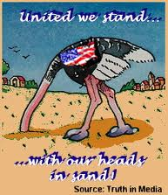
Contributing Factors to the Holocaust
3. The Holocaust occurred because certain groups and individuals chose not to act.
Notes:
Remind students that the U.S. was one of those groups. A boat full of Jewish refugees was turned away, due to immigration regulations.

Slide 14
Who was persecuted by the Nazis?
Jews of Europe
Roma or gypsies
Mentally and physically handicapped people
Jehovah’s witnesses
Homosexuals
And anyone who aided these groups or didn’t support the Nazis.
Notes:
Besides Jews, what two groups surprised you the most?

Slide 15
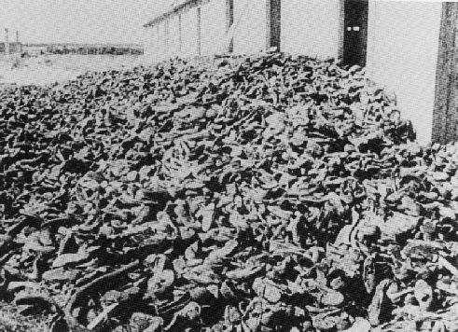
These were not just numbers!! These were real people with families, ideas, feelings, friends, hopes, and dreams just like you and me.
Notes:
Picture of shoes taken from concentration/death camp prisoners.

Slide 16
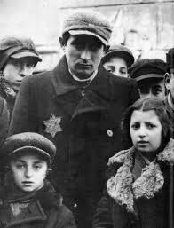
What led to the “Final Solution”?
Hitler’s “Final Solution” for the Jews was to exterminate or kill the entire race.
Notes:
This “solution” did not happen overnight. There many seemingly small acts and decisions that led to this.

Slide 17
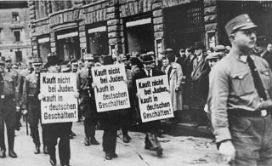
Steps to the Holocaust:
1) It began with the idea that one race or group of people is better than another group.
2) Next came little persecutions or abuses (name calling, harassment, small acts of violence.)
Notes:
Kind of scary that something so horrific could begin with a simple idea followed by name calling. Have you ever called someone a name? bullied someone for their choices?
Other examples of persecution included Jewish businesses being shut down, children not allowed to go to school, synagogues shut down, Jews denied access to public entertainment.

Slide 18
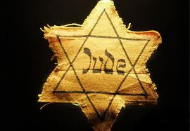
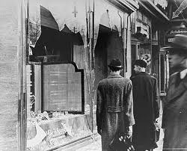
Steps to the Holocaust:
3) Many Jews weren’t allowed to enter certain stores.
4) Jews had to wear a star on their clothing to set them apart from everyone else.
5) Jewish businesses & homes were often attacked and destroyed. Violence against Jews became “normal”.
Notes:
Kristallnacht, literally, "Night of Crystal," is often referred to as the "Night of Broken Glass." The name refers to the wave of violent anti-Jewish attacks which took place on November 9 and 10, 1938, throughout Germany, annexed Austria, and in areas of the Sudetenland in Czechoslovakia recently occupied by German troops. These attacks were instigated by Nazi party officials.

Slide 19
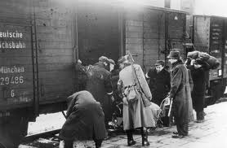
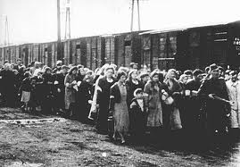
Steps to the Holocaust:
6) Around 1939, concentration camps were developed and Jewish and other groups were gathered and sent to these camps.
7) Ghettos, transit camps, and forced-labor camps were also developed.
Notes:
Students often ask why the Jews allowed themselves to be taken so peacefully. Remind students that they did not know what awaited them—there were often rumors of what their fate might be, but they could not imagine that something so terrible could actually happen to them, so the rumors were often disregarded.

Slide 20
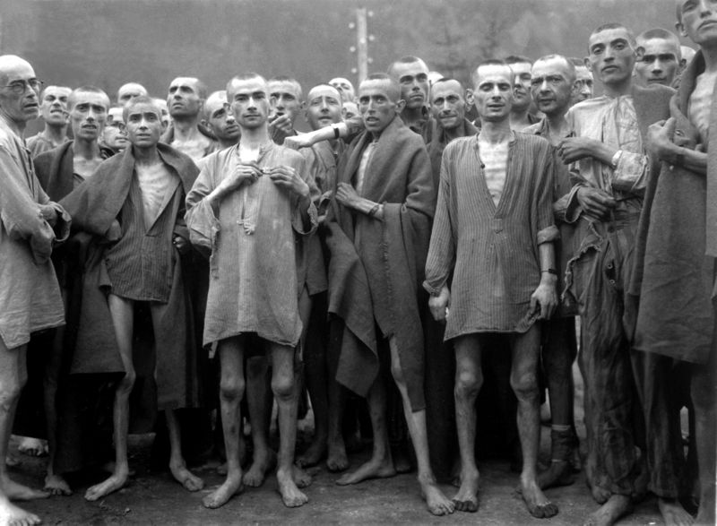
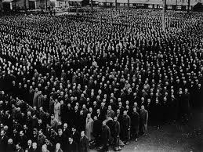
Steps to the Holocaust:
8) Many people died in these camps from mistreatment, starvation, and disease.
9) Men, women, children, old, young, strong, or weak--it made no difference to the Nazis.

Slide 21
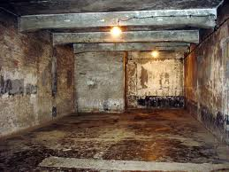
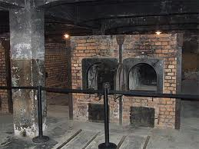
Steps to the Holocaust:
10) In the final months of the war, extermination camps were developed where millions more people were murdered.
Also death marches were performed in order to prevent the freeing of prisoners.
Notes:
Picture of gas chambers—the doors of which were often marked with “shower.” They would pack as many people as possible into the room and instead of water coming out of the pipes, it was poisonous gas. The second picture is of the ovens used to cremate the bodies after the gassing.

Slide 22
In 3-5 sentences, summarize how the Holocaust grew from an idea to mass murder?

Slide 23
Types of People Involved with the Holocaust:
Bystanders--didn’t do anything for or against the Holocaust. “Closed eyes” people.
Collaborators--aided in persecutions or murders. “Go along for the ride” people.
Perpetrators--made the decisions and caused action to take place. “The brains” behind the action.
Rescuers--took action against the Holocaust and tried to help those who were being persecuted and murdered. The “go-getter” heroes.
Notes:
Quick Write: Which group of people do you think you would have belonged to and why?

Slide 24
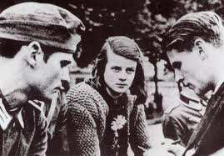
Types of Resistance
Physical act of revolt.
The smuggling of messages, food, weapons to prisoners or Ally forces.
The practice of religious and cultural traditions in defiance of rules established by the Nazis.
The creating of fine art, music, and poetry inside ghettos and concentration camps.

Slide 25
Why did it take so long for the US to get involved?
At the time the U.S. had a strong anti-involvement policy. We wanted to just keep to ourselves and let everyone else solve their own problems.
The U.S. really wasn’t located anywhere near where all of this was taking place.
The U.S. was trying to cope with the Great Depression.
Reports of what was happening were generally not printed in the US press. Americans had little idea about what was happening in Europe.

Slide 26
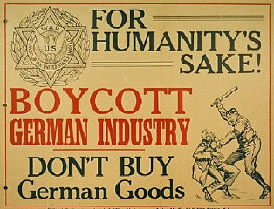
Eventually, the US did become involved.

Slide 27
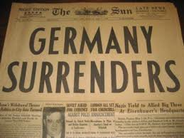
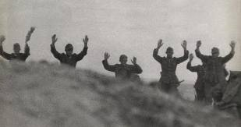
The End of the War
Germany surrendered on May 9, 1945, ending the war in Europe.
Japan surrendered on September 2, 1945, ending the war in the Pacific.
World War II resulted in an estimated 55 million deaths worldwide.

Slide 28
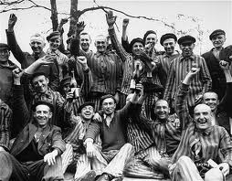
The Aftermath:
In 1945, when Allied troops entered the concentration camps, they discovered piles of bones and ashes--evidence of the millions murdered.
Soldiers also found thousands of survivors suffering from starvation and disease.
After liberation, many survivors refused to return to their former homes because of the racism that still persisted in many parts of Europe.
Notes:
Picture of freed prisoners.

Slide 29
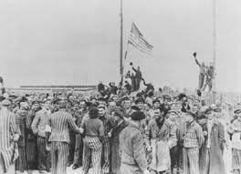
The Aftermath:
Many survivors had no home to return to.
Displaced persons camps were established for homeless survivors.
Many organizations were organized to offer relief and help to these survivors.
Many immigrated out of Europe.
Some countries are still struggling to re-build their country after the devastation of World War II.
Notes:
Picture of American soldiers hoisting the flag after liberating a camp.

Slide 30
Think Questions:
Why did such a terrible thing happen?
Why was it allowed to happen?
Could something like the Holocaust happen again?
What similarities can you find between what happened back then and what is happening now?
What can we do to prevent something like this from happening again?
Notes:
Quick Write: Choose one question and write a thoughtful paragraph response.

